Slide 1
Social Network Analysis – Github Activities
Sean P. Goggins, Ph.D
Associate Professor, University of Missouri
Notes:
In February, I knew no “R”. Thanks to many of your online lectures, examples and slides I am now nominally competent to analyze my data in R. Thank you.

Slide 2
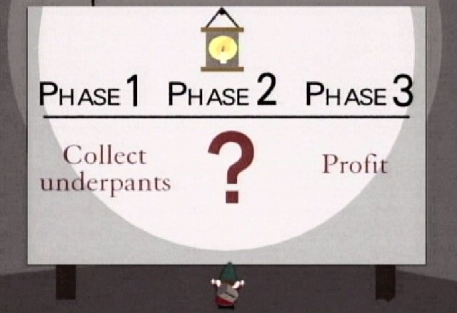
Underpants Gnomes
Motivation
With much discourtesy from the US TV Program “South Park”
Notes:
A problem with much analysis of internet systems today

Slide 3
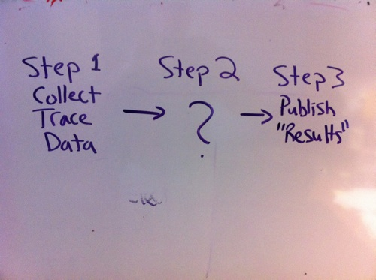
Underpants Gnomes
Motivation

Slide 4
Addressing The Underpants Gnome Postulate

Slide 5
Group Informatics Described
Discussion Post
Open Coding
Identification of Coordination Events
Time proximity
Topical proximity
Classification
Read
Response
Axial Coding
Aggregation of Posts by Topic
Weighted Network Analysis of Interactions
Identify Key
Information
Brokers
Weight Connections Based on Time Distance, Grouped
By Topic and informed by analysis of time distance between posts.
Methodological Approach

Slide 6
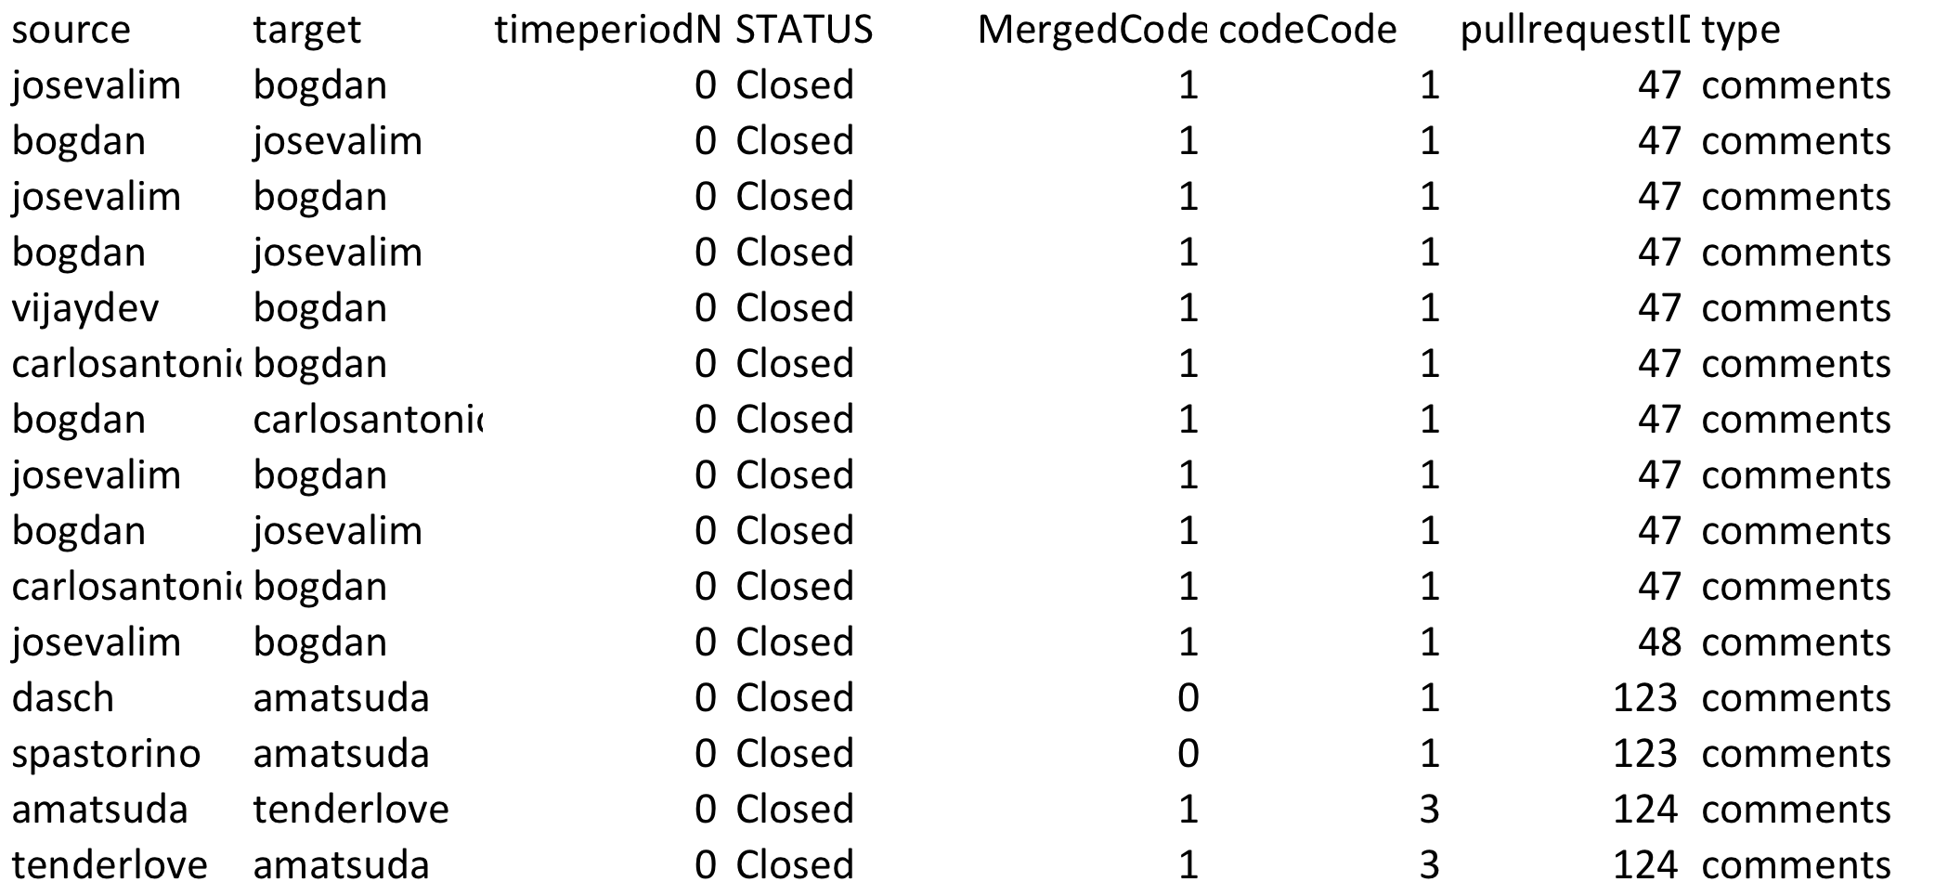
Data: Github

Slide 7
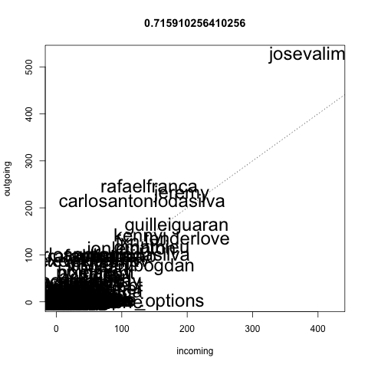
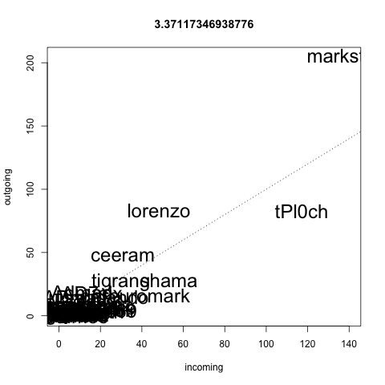
Github Network Activity One

Slide 8
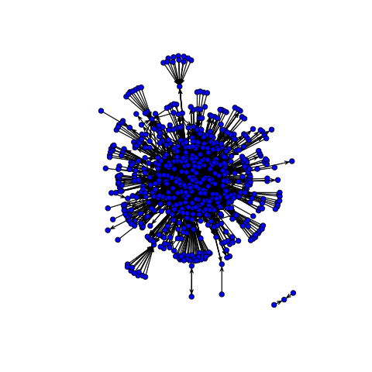
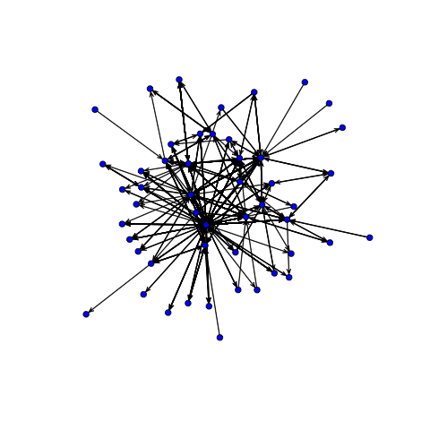

Slide 9
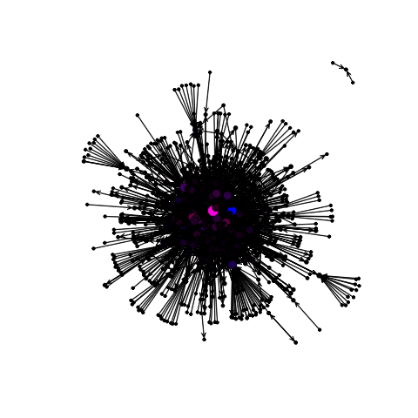
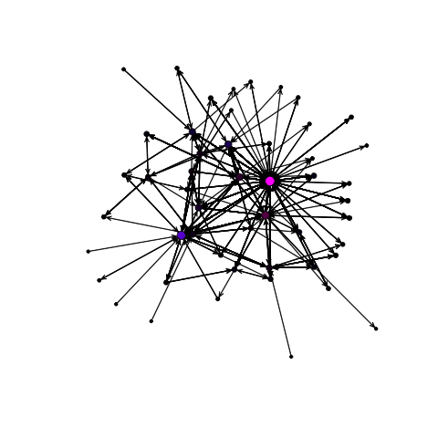

Slide 10
Actual R – Code
Work through setup
Scripts are ready to run
Talk Through Them and Walk around to help

Slide 11
Further Analysis Tools
Eight Mylyn Releases (Temporal Analysis)
R Packages Used
TNET
iGraph
Statnet

Slide 12
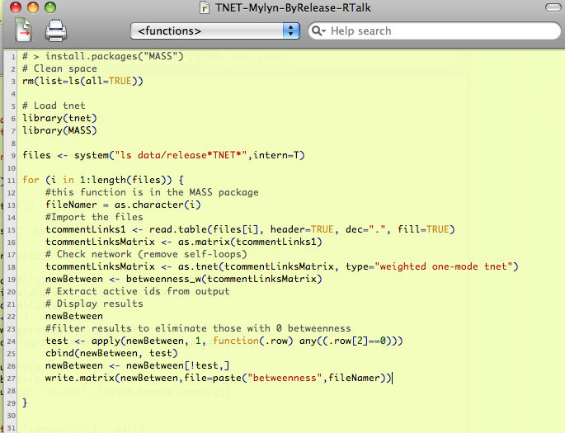
Weighted Network: TNET
Notes:
TNET is a package I would turn you on to if you need to consider weighted network measures. The data structure is a little different than STATNET or iGraph. When you are working with small world data that is relatively closed, the weights of the connection become very important to the analysis.

Slide 13
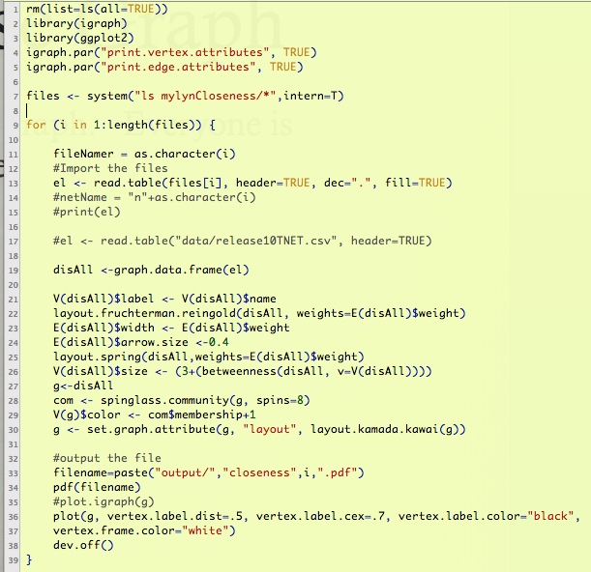
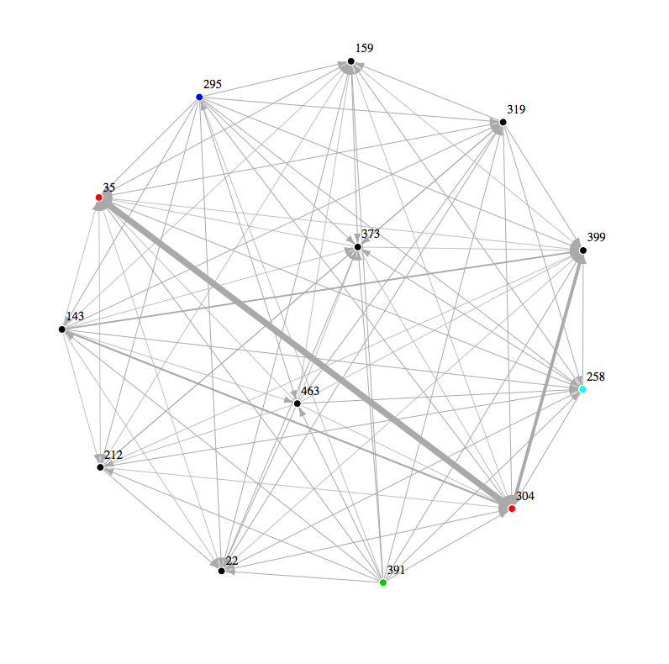
The Dense Graph (Work)
Developers create a dense graph. Not a complete graph, but dense.
Work

Slide 14
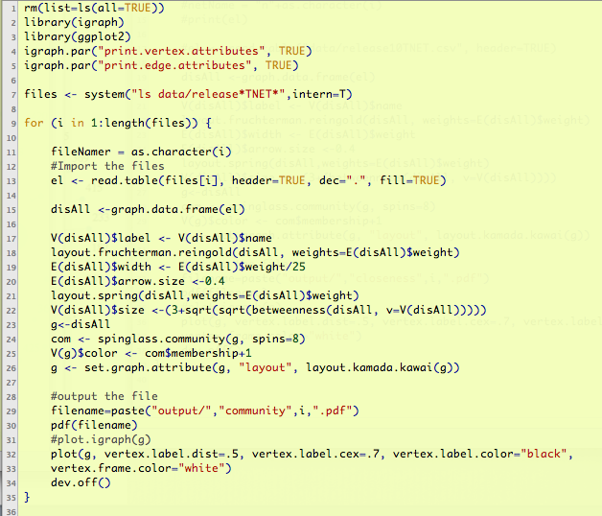
A Sparser Graph (Talk)
Commenter's create a sparse graph
Talk

Slide 15
Release One (2.0) Analysis
Release 1
Discussion
Code
Talk
Work
iGraph

Slide 16
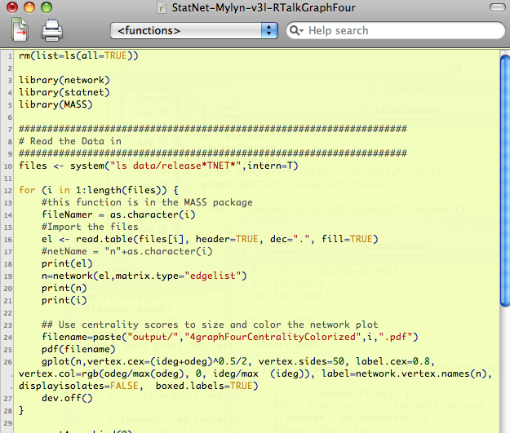
STATNET for Discussion
StatNet
Red = Bug Commenter
Blue = Bug Opener
Release 1
Talk
StatNET

Slide 17
Release One
Work & Talk

Slide 18
Release 1 (2.0) iGraph & Statnet
Talk
Red = Bug Commenter
Blue = Bug Opener
Clusters
Release 1
StatNET
In Degree &
Out Degree
iGraph

Slide 19
Release One (2.0): Filtered
Code
Discussion
Talk
Release 1
Work
Google Summer Coder
304, 373, 399 & 143 form
The Strongest Connections
In both networks
Red = Bug Commenter
Blue = Bug Opener
Notes:
Here we have filtered the developer code for the strongest connections.

Slide 20
Release One (2.0): Filtered
Code
Work
Discussion
Talk
Release 1
457, 391 & 159 –
Comment & Open
Google Summer Coder
304, 373, 399 & 143 form
The Strongest Connections
In both networks
Red = Bug Commenter
Blue = Bug Opener
Notes:
Here we have filtered the developer code for the strongest connections.

Slide 21
Compare Over Time
First & Last Release

Slide 22
Release 1 (2.0) Compared to Release 8 (3.3)
Release 1
Talk
Release 8
304, 399, 143, 159, 173, 373
399, 118, 304, 159, 391, 416
StatNET & ordinary plotting

Slide 23
Release 1 (2.0) Compared to Release 8 (3.3)
Work
Release 1
143 & 304 disengaged
Or missing entirely
Release 8
304, 373, 399 & 143
Two disconnected
Graphs in release 8
iGraph

Slide 24
Release Eight
Work & Talk

Slide 25
Release 8 (3.3): Filtered
Discussion
Code
Release 8
Talk
Nobody is
“Just Blue”
Work
Red = Bug Commenter
Blue = Bug Opener
Notes:
304 & 399 are the story
Statnet is centrality.
89, 276 & 301 are commenters who do not write code.

Slide 26
Release 8 (3.3): Filtered
Release 8
Discussion
Code
Talk
Work
Notice 416 in Talk & Second Coder Graph
Red = Bug Commenter
Blue = Bug Opener
Notes:
416 is part of the disconnected graph, and has two other folks connected to it. That person also shows up in the discussion graph.

Slide 27
Release 8 (3.3) iGraph & Statnet
399, 118 & 159 are significant, But play with different clusters of Other people.
Release 8
Talk
Red = Bug Commenter
Blue = Bug Opener
Clusters
StatNET
In Degree &
Out Degree
Blue
Cluster
iGraph

Slide 28
Releases One → Eight
High Level Views Over Time

Slide 29
Discussion, Releases 1 – 8
Where there is no color,
There are multiple, incomplete
Graphs.
Notes:
When the graph is connected in a community of this size, it may indicate some level of cohesiveness that does not exist when the graph is incomplete. We know that major changes took place during the periods leading up to 3.3, and it is interesting to us that the final release we studied shows a complete discussion graph once again. It suggests that a new, larger community with several clusters has emerged. And the structure is different than it was the last time.

Slide 30
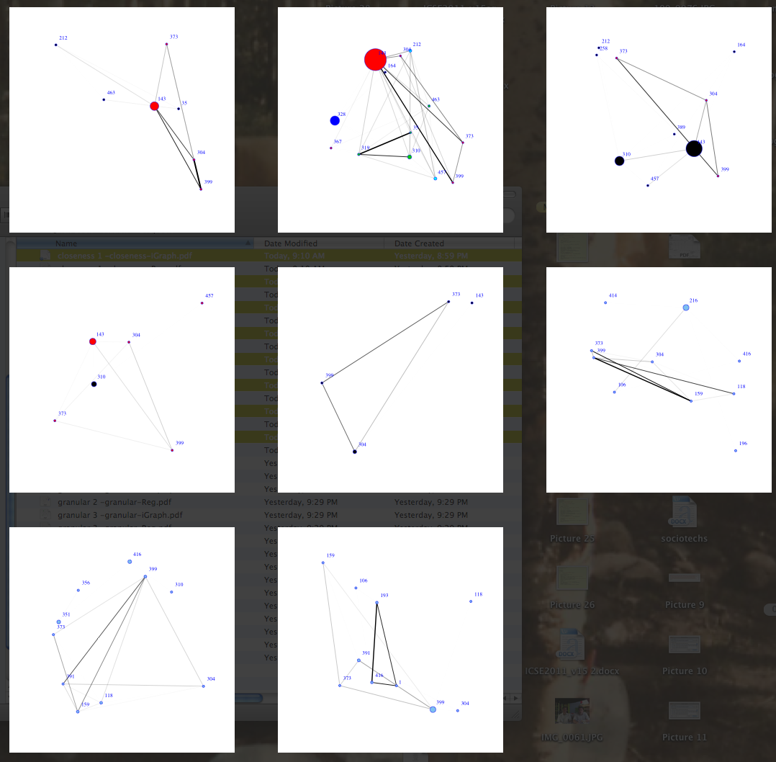
Code, Releases 1 – 8
One Possible explanation:
A few central
People who slowly but
Observably begin to engage
Other contributors in
An open source software
Development project.
Structure evolves
Key Groups Evolve
iGraph

Slide 31
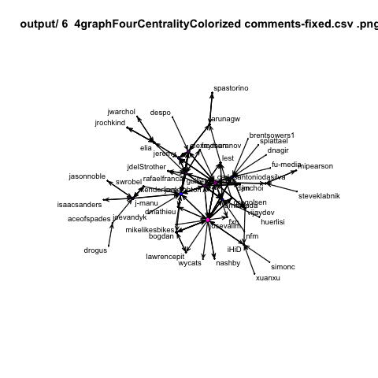
Github: Longitudinal

Slide 32
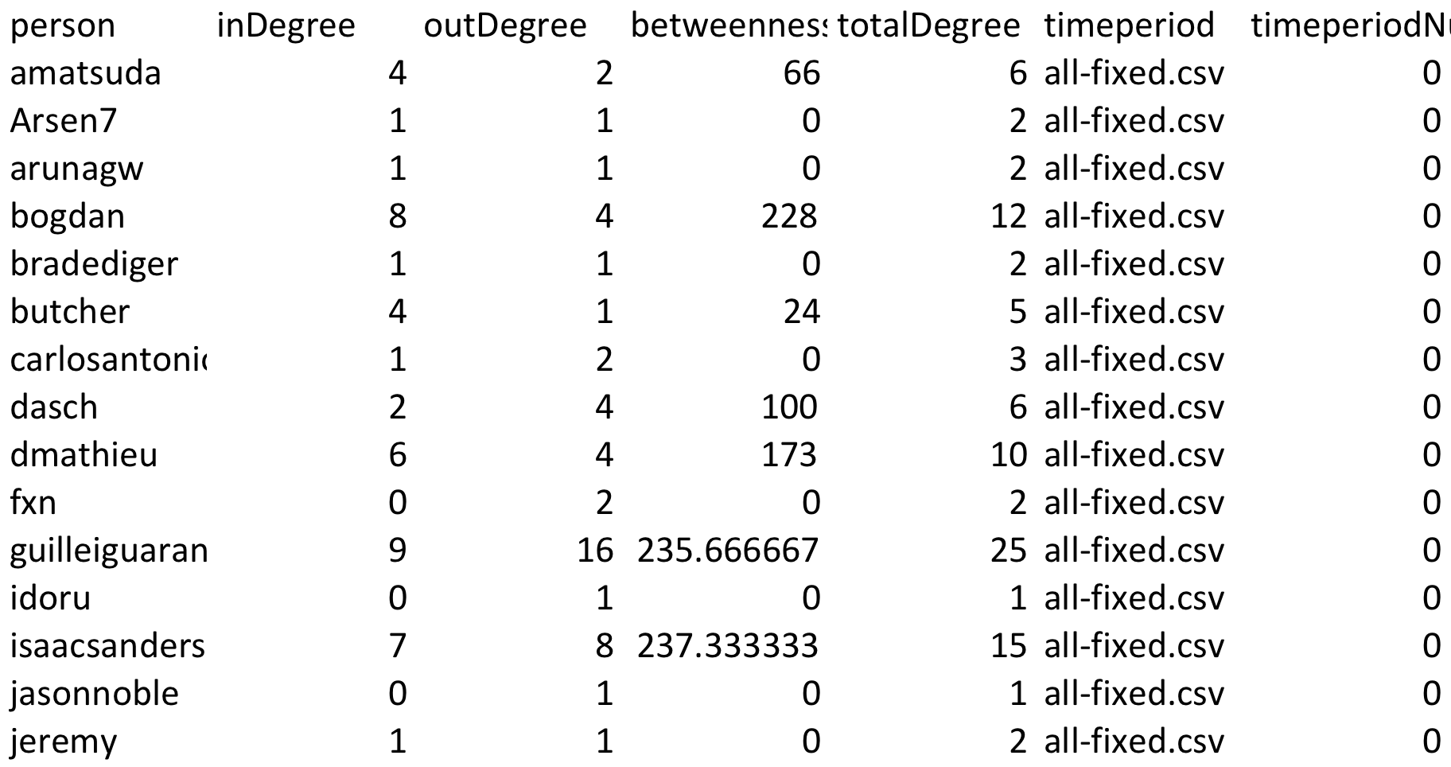
Github Statnet Summaries

Slide 33
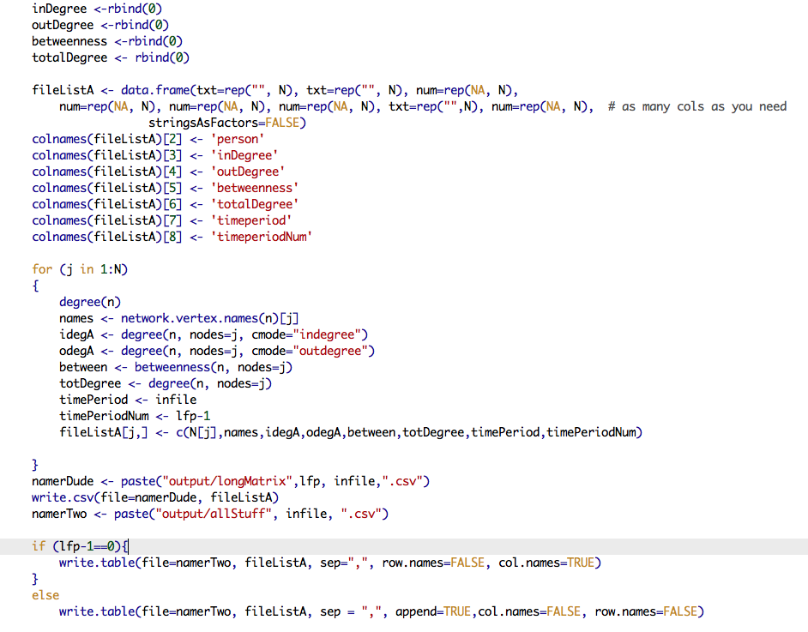
Built with This R Code

Slide 34
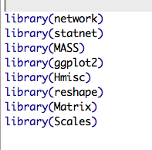
Longitudinal Network Libraries

Slide 35
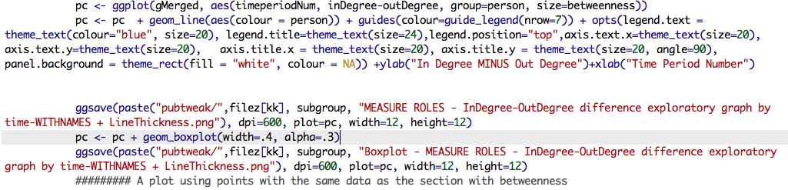
GGPLOT2 Code
pc <- ggplot(gMerged, aes(timeperiodNum, inDegree-outDegree, group=person, size=betweenness))
pc <- pc + geom_line(aes(colour = person)) + guides(colour=guide_legend(nrow=7)) + opts(legend.text = theme_text(colour="blue", size=20), legend.title=theme_text(size=24),legend.position="top",axis.text.x=theme_text(size=20), axis.text.y=theme_text(size=20), axis.title.x = theme_text(size=20), axis.title.y = theme_text(size=20, angle=90), panel.background = theme_rect(fill = "white", colour = NA)) +ylab("In Degree MINUS Out Degree")+xlab("Time Period Number")

Slide 36
Github Longitudinal

Slide 37
GGPLOT2 Code
pc <- ggplot(gMerged, aes(timeperiodNum, inDegree-outDegree, group=person, size=betweenness))
pc <- pc + geom_line(aes(colour = person)) + guides(colour=guide_legend(nrow=7)) + opts(legend.text = theme_text(colour="blue", size=20), legend.title=theme_text(size=24),legend.position="top",axis.text.x=theme_text(size=20), axis.text.y=theme_text(size=20), axis.title.x = theme_text(size=20), axis.title.y = theme_text(size=20, angle=90), panel.background = theme_rect(fill = "white", colour = NA)) +ylab("In Degree MINUS Out Degree")+xlab("Time Period Number")

Slide 38
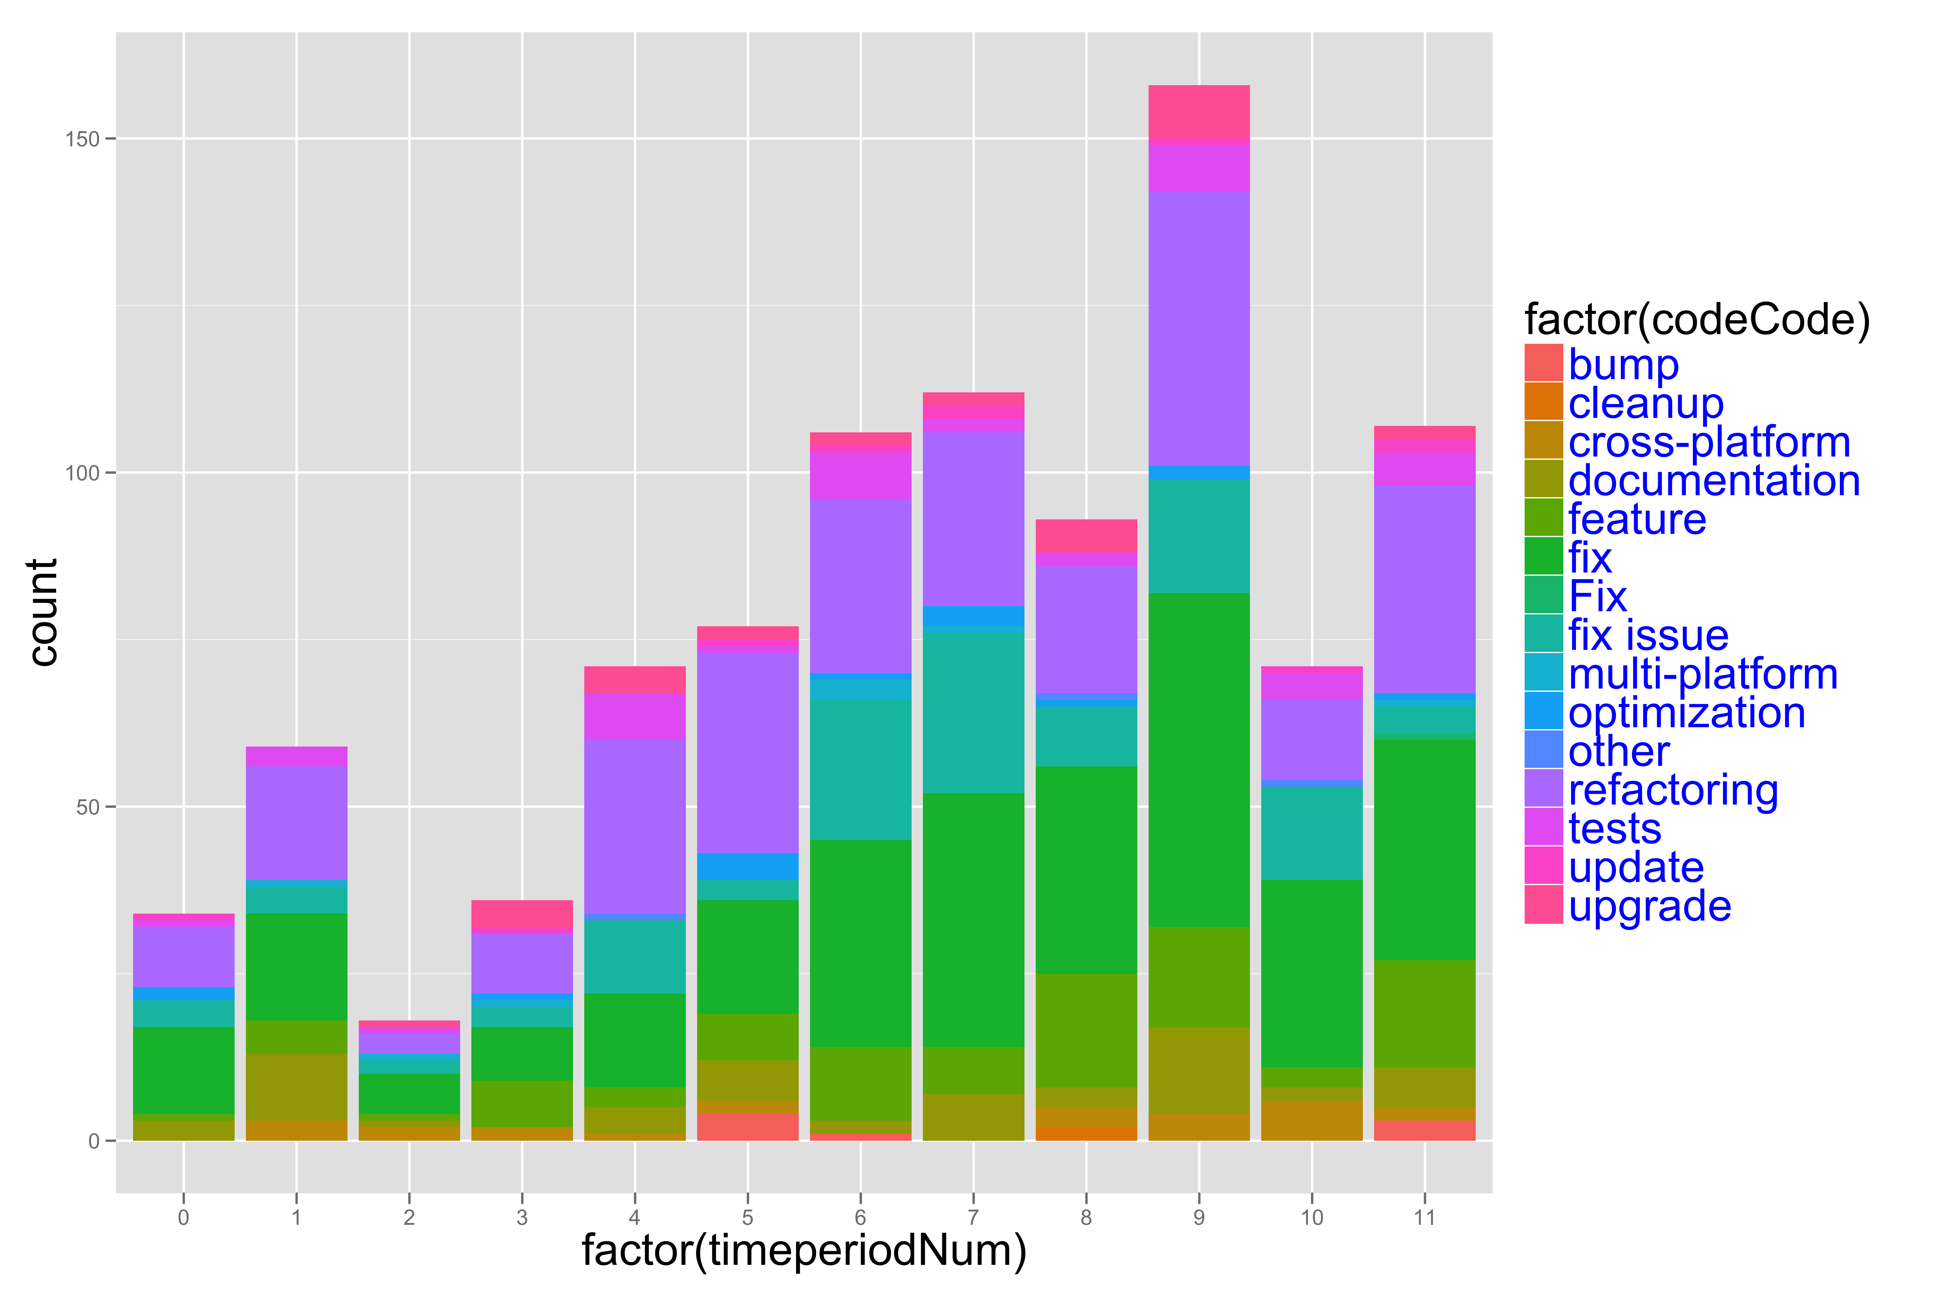
GITHUB: Types of Work

Slide 39
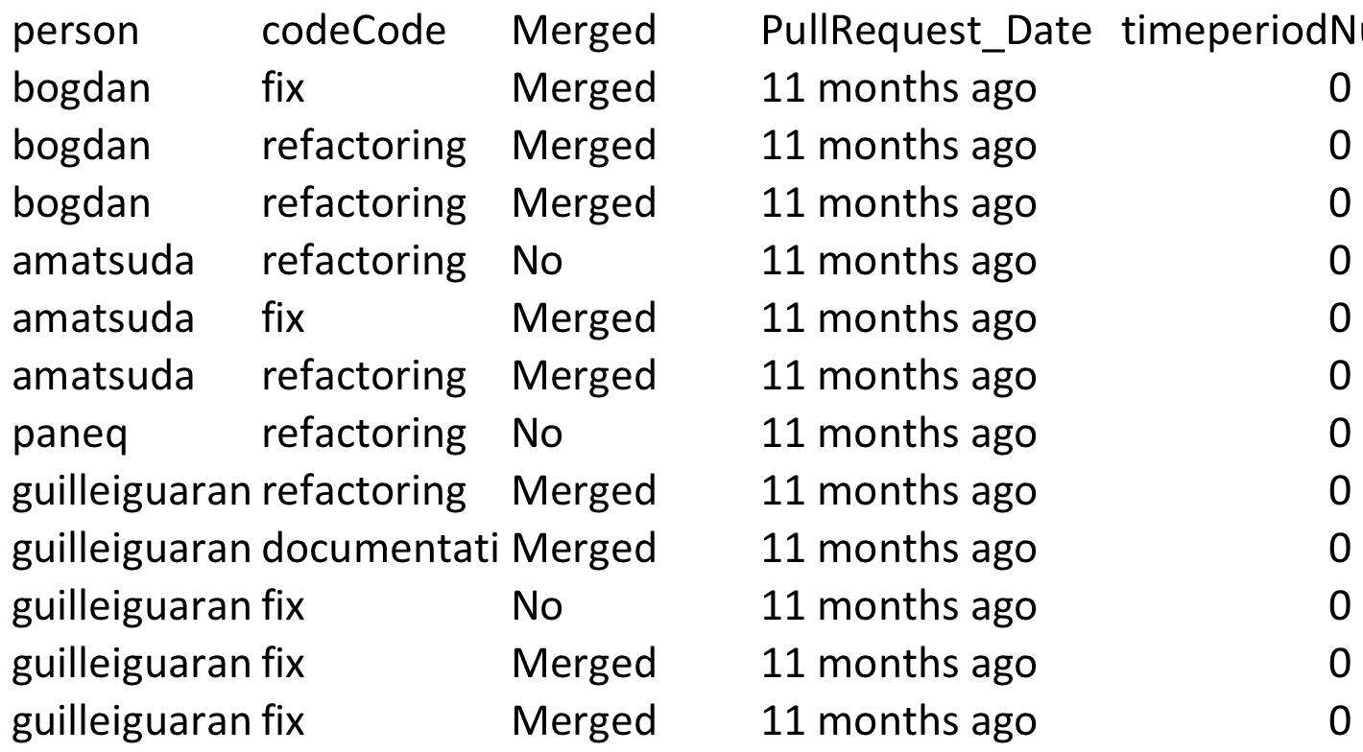
Code & Data for Types of Work
gg <- ggplot(pullerListTyped, aes(timeperiodNum, fill=person))+geom_bar()+facet_grid(facets=codeCode~.)
ggsave("fix-feature-pullers.png", dpi=600, plot=gg, width=12, height=12)

